Slide 1
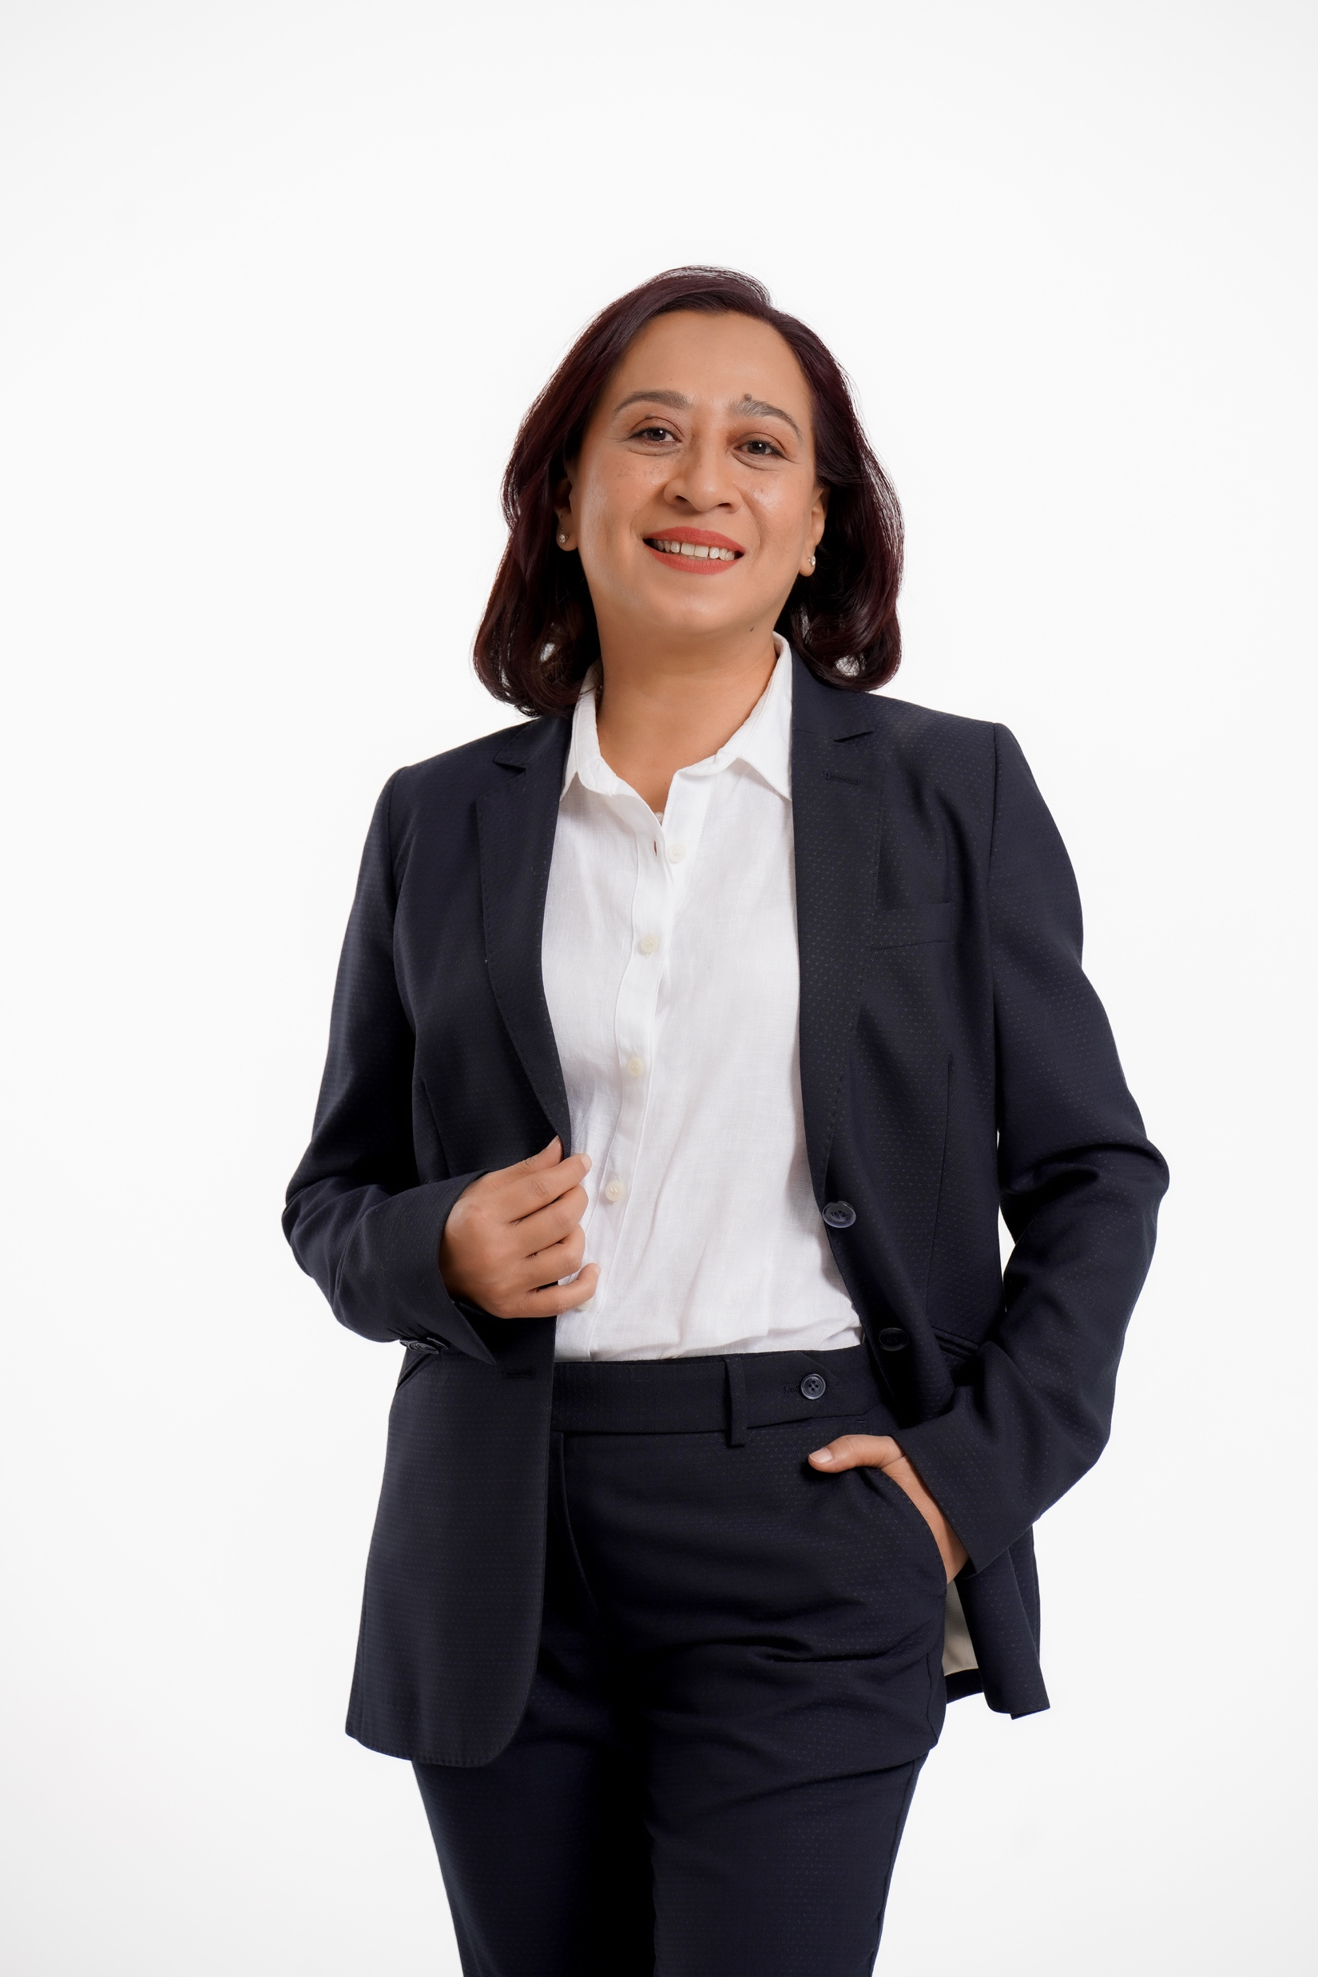
EMCEE • PRESENTER
ENGLISH • BAHASA MALAYSIA
Shasha
Marican
Notes:
[Sources]
- User-confirmed professional name and languages, 2026-08-05.
[/Sources]

Slide 2
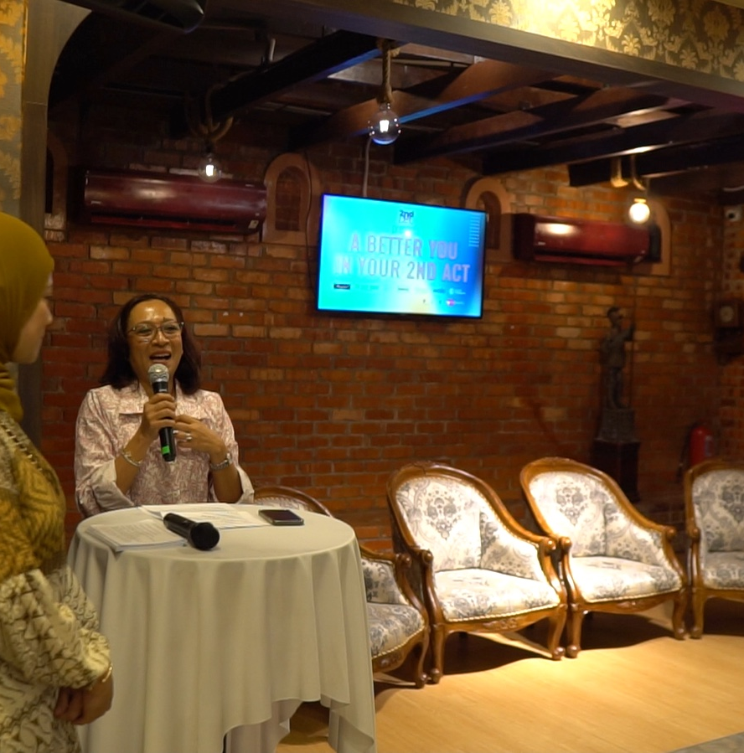
A seasoned communicator who understands the whole room
Warm presence. Strategic mind.
Shasha Marican is a bilingual emcee and presenter with more than two decades of experience in strategic communications, event management and stakeholder engagement. She brings clarity, warmth and composure to every stage - whether guiding a formal programme, representing a brand or connecting with a lively audience.
Her behind-the-scenes understanding of event flow allows her to anticipate transitions, support speakers and keep the audience experience moving naturally.
WARM • ARTICULATE • PROFESSIONAL • ADAPTABLE
2
Notes:
[Sources]
- Shasha CV: /Users/rizalnoor/Desktop/Work/Shasha/CV/Shasha CV.pdf
- User-confirmed bilingual hosting capability, 2026-08-05.
- Supplied 2nd Act footage: /Users/rizalnoor/Desktop/Work/2nd Act/Resources/Videos Footages/drive-download-20250511T012716Z-1-001/C0063.MP4
[/Sources]

Slide 3
Three roles demonstrate her range on stage
MIHAS Modest Fashion Show
Full emcee for the 2025 fashion-show segment, guiding the programme, stage transitions and audience experience with confidence and polish.
4U2C: Bringing Back Da 90s Flava
Official spokesperson in 2025, representing the event in a media-facing environment and communicating its energy, purpose and audience promise.
The 2nd Act Event Series
Creator of the event platform as well as its full emcee and host - shaping the concept, programme flow and connection between speakers and audience.
2025
WATCH REEL
WATCH VIDEO
3
Notes:
[Sources]
- User-confirmed roles and dates, 2026-08-05.
- MIHAS stage image: /Users/rizalnoor/Desktop/Screenshot/Screenshot 2026-08-05 at 12.50.07 PM.png
- 4U2C reel: https://www.facebook.com/reel/2297096360693103
- Supplied 2nd Act footage: /Users/rizalnoor/Desktop/Work/2nd Act/Resources/Videos Footages/drive-download-20250511T012716Z-1-001/C0063.MP4
[/Sources]
[Sources]
- Clickable 4U2C action reel: https://www.facebook.com/reel/2297096360693103
- Clickable hosted 2nd Act action video: https://shasha-lara-emcee.r1z4ln00r.chatgpt.site/#watch
[/Sources]

Slide 4
Her experience spans culture, motorsports and fashion
Restaurant Sri Melayu Cultural Performances
Began emceeing in the 1990s, hosting a 45-minute cultural presentation of Malaysian traditional dances for restaurant guests.
Sepang International Circuit
In-house emcee during her 2000-2001 employment, hosting press conferences, the motocross-track launch and go-kart racing events at the circuit.
Arlina Ayou Boutique Launch
Upcoming emcee engagement for the launch of fashion designer Arlina Ayou's boutique on 24 August 2026.
1990s
2000-2001
24 AUG 2026
4
Notes:
[Sources]
- User-provided experience, 2026-08-05: Restaurant Sri Melayu cultural performances in the 1990s; 45-minute Malaysian traditional-dance programme.
- User-provided experience, 2026-08-05: in-house emcee at Sepang International Circuit during 2000-2001 employment; press conferences, motocross-track launch and go-kart racing events.
- User-provided upcoming engagement, 2026-08-05: Arlina Ayou fashion-boutique launch on 24 August 2026.
[/Sources]

