Slide 1
EMCEE • HOST • PERFORMER
ENGLISH • SHAH ALAM
Lara Alya
Rizal
Notes:
[Sources]
- User-provided name, preferred name, language and city, 2026-08-05.
[/Sources]

Slide 2
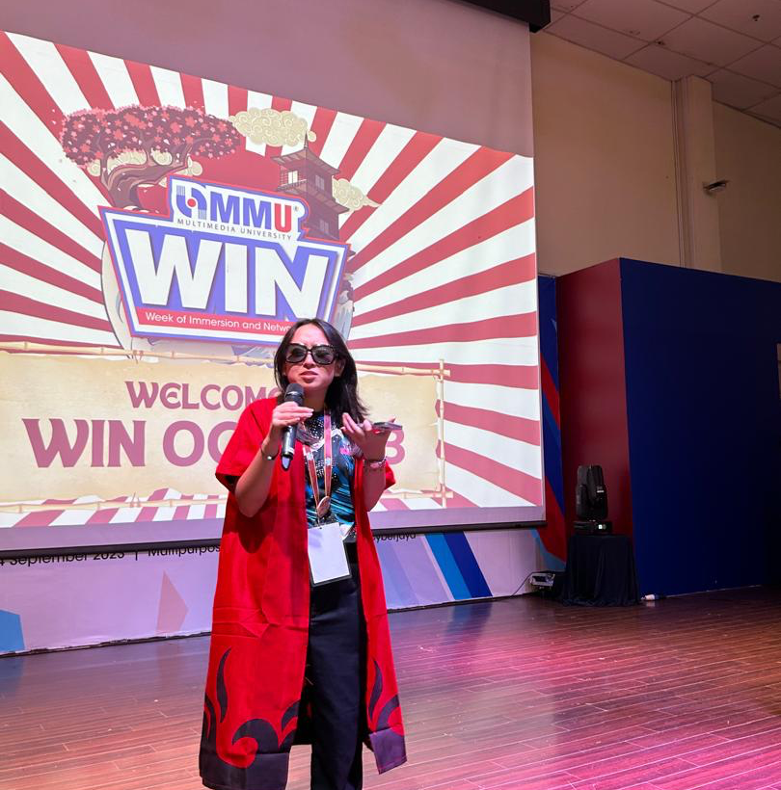
Youthful energy with a proven university track record
Fun. Energetic. Naturally engaging.
Lara Alya Rizal is a 22-year-old English-language emcee from Shah Alam with seven hosting engagements across three years at Multimedia University.
Her relaxed, humorous approach helps audiences feel involved, while her public-speaking and performance experience gives her the confidence to keep programmes lively and transitions natural.
She is especially suited to festivals, orientation programmes, concerts and youth-focused events where personality and audience connection matter.
7 EVENTS • 2023-2025 • REPEAT ORIENTATION HOST
2
Notes:
[Sources]
- User-provided age, language, city, style and experience count, 2026-08-05.
- Supplied WIN orientation photograph: /var/folders/_9/cbcy8hv944l5yz9md8qb8q280000gn/T/codex-clipboard-abac988e-1380-4282-b629-20cb46e95bee.png
[/Sources]

Slide 3
Seven events build a clear track record
Five emcee engagements
Orientation Programme - WIN (Oct)
Clubs & Societies Registration Week (Nov)
Convocation Festival
Campusfest K-ROYALE DANCE (Dec)
INTER(FAC)E Music Festival
A more formal stage
Emcee for the Multimedia University Siti Hasmah Orchestra, adding a formal cultural engagement to her hosting experience.
Invited back for orientation
Returned as emcee for Multimedia University's WIN Orientation Programme in March 2025 - demonstrating continuity and trusted stage presence.
2023
2024
2025
3
Notes:
[Sources]
- Complete event list and dates supplied by user, 2026-08-05.
[/Sources]

Slide 4
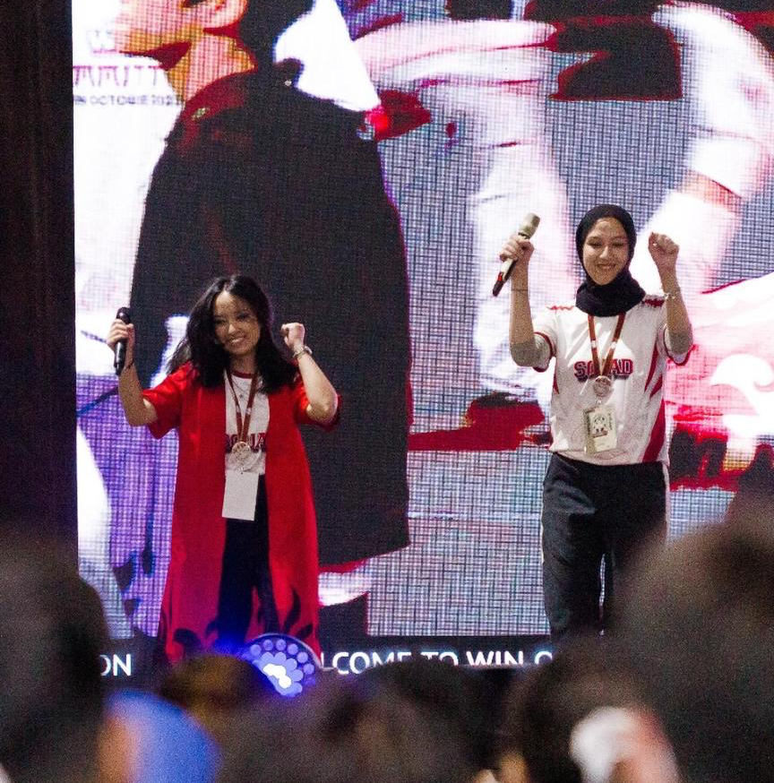
Built for lively rooms and live audiences
Hosting style
Fun • Energetic • Humorous • Informal
Best suited to
Festivals • Orientations • Concerts
Creative talents
Public speaking • Interviewing • Acting • Singing
Lara combines the instincts of a host with the confidence of a performer - helping her respond naturally to the room and keep audiences engaged.
4
Notes:
[Sources]
- User-provided hosting style, event types and talents, 2026-08-05.
- Supplied stage photograph: /var/folders/_9/cbcy8hv944l5yz9md8qb8q280000gn/T/codex-clipboard-e4c329b7-b9ea-45af-b38d-8283e9cf844f.png
[/Sources]

